Slide 1
Evaluation of Thermal Efficiency of a Simple Waste Heat Recovery cum Seawater Desalination
System Coupled with an ORC Cycle
Paper no - 158
Animesh Singh Arpit Kedia
Rudrodip Majumdar Sandip Kumar Saha

Slide 2
Motivation
Minimization of the carbon footprint left by high temperature industrial effluents on large water bodies (e.g. sea).
Extraction of excess heat through thermodynamic cycle (ORC).
Harnessing of freshwater as an additional goal ensuring better utilisation of waste heat.
Protection of marine ecosystem
Production of potable water

Slide 3
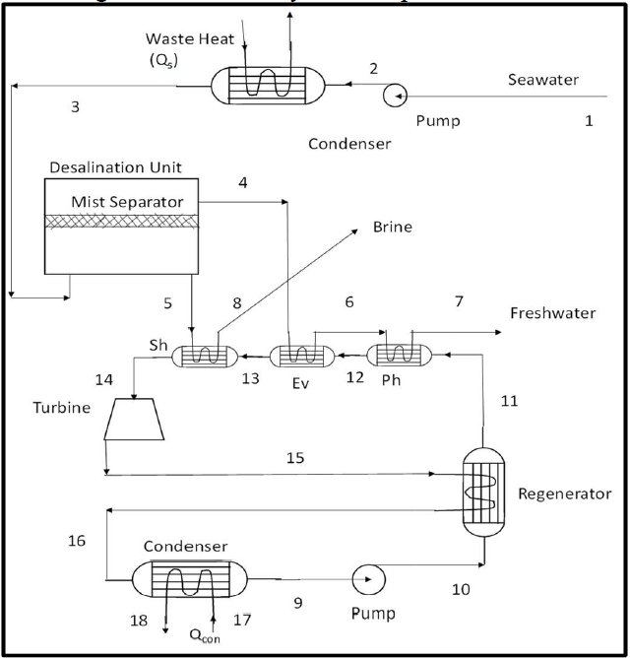
System Schematic
Sh - Superheater
Ev - Evaporator
Ph - Preheater
Notes:
Why ORC

Slide 4
Assumptions
Steady-state conditions are assumed for all components.
The heat and friction losses are neglected.
The kinetic and potential energy changes are negligible.
A subcritical turbine is used in the ORC cycle.
The pressure drop is ignored in the superheater, evaporator, preheater, regenerator and condenser of the ORC.
The energy required to maintain the pressure of the desalination unit is negligible.

Slide 5
Choice of ORC fluids
We have studied butane, isobutane, pentane, isopentane, R152a, R245fa, R143a, R236fa and R22.
These have been chosen keeping in mind the temperature ranges.
Governing Equations: Simple energy and mass balance calculations have been done.
Notes:
152 difluro ethane
R143a 1,1,1-Trifluoroethane
245fa 1,1,1,3,3-Pentafluoropropane
R22 Chlorodifluoromethane
R236fa 1,1,1,3,3,3-Hexafluoropropane

Slide 6
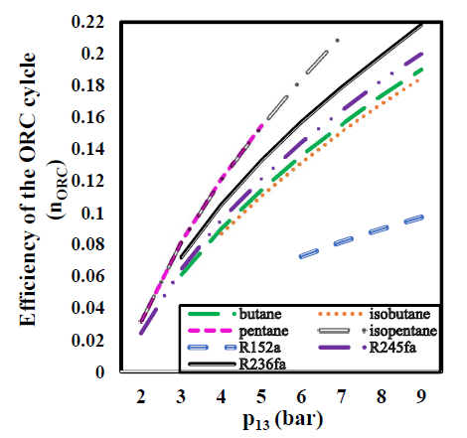
Results(1/3)
Notes:
Slope is more

Slide 7
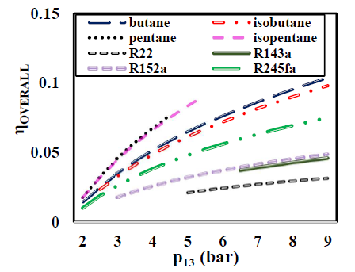
Results(2/3)

Slide 8
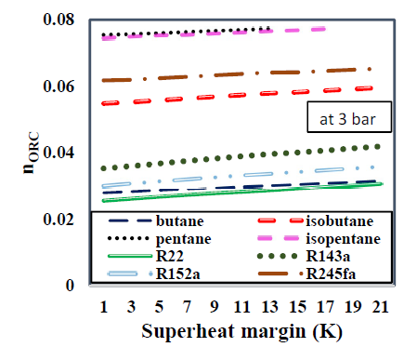
Results(3/3)

Slide 9
Conclusions
Interesting find: As the fraction of separated freshwater increases, the efficiency of ORC decreases.
The evaporating pressure of the bottom ORC is found to be the pivotal factor, that influences overall energy utilization in the process.
The superheating temperature margin results in an enhancement in the thermodynamic efficiency of the proposed system.

Slide 10
Future Scope
Coupling of bottom ORC to different configurations of waste heat streams.
Study on zeotropic mixtures in the context of ORC, in order to maximize efficiency of ORC.
Choice of working fluids based on the waste heat stream temperature and the bottom cycle evaporating pressure.
Notes:
Prof haglind, denmark

Slide 11
Thank You

